Slide 1

tAbleau

Slide 2
What is Business Intelligence?
BI is a technology-driven process that analyses data and provides actionable information, for better decisions.
Aim - Drive a positive change to improve the company's performance and revenue.
BI encompasses a variety of processes such as data mining, data analysis, KPIs, visualisations, etc.
It deals with the "what" and "how," of a business, unlike business analytics, that deals with the "why" and "what next."

Slide 3
Who uses BI and why?
People from departments like - sales, marketing, finance, operations, data science, data analysis, etc.
Tasks include - Statistical analysis, performance measurement against business objectives, gaining customer insights, and communicating data to identify better future opportunities.

Slide 4
Data visualization
Data visualisation is the graphical depiction of information and data.
It is a form of visual art that captures our attention.
The tools which include visual components like charts, graphs, maps, etc. come in handy to view and understand trends, outliers, and patterns in data.

Slide 5
Furthermore, it allows employees or entrepreneurs to communicate facts to non-technical people without creating confusion.
Data visualisation tools and techniques are critical in this Big Data age, for analysing huge volumes of data and making data-driven (strategic decisions based on data analysis and interpretations) decisions.

Slide 6
Benefits of data visualisation
Colours and patterns catch our attention.
Humans can quickly distinguish between red and blue, as well as squares and circles.
When we look at a chart, we immediately spot trends and outliers.
If you can't find a trend when you look at a huge spreadsheet of data, visualisation becomes important.
Also, with visualization, information can be shared quickly and easily.

Slide 7
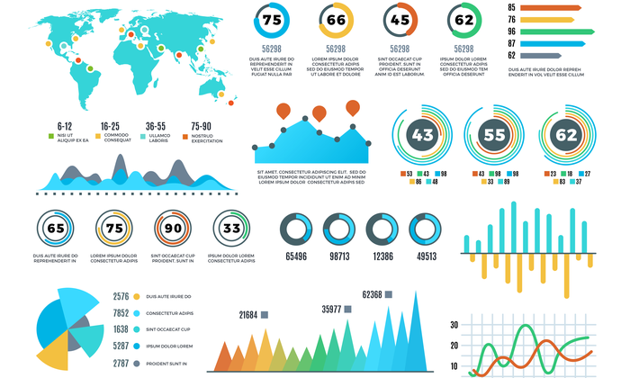
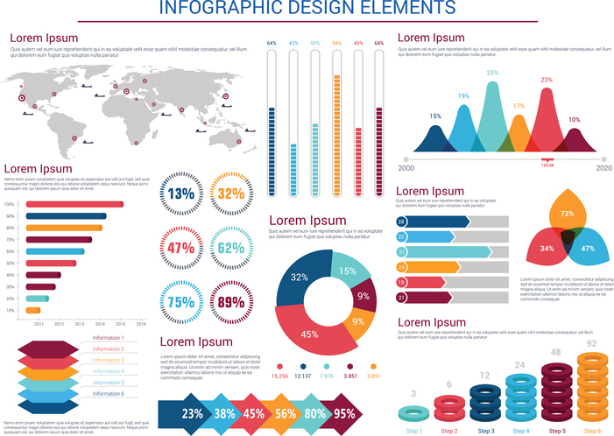

Slide 8
Tableau
Tableau is a highly effective and rapidly expanding data visualisation application used in the Business Intelligence Industry.
It aids in the simplification of raw data very much clearly.
Tableau assists in the creation of data that can be grasped by people at all stages of an organisation.
Non-technical people can easily build customized dashboards.
The Tableau tool analyses data swiftly and delivers visualisations in the form of dashboards and workbooks.

Slide 9
System requirements
Microsoft Windows 8/8.1, Windows 10 (x64)
4 GB memory
1.5 GB minimum free disk space
CPUs must support SSE4.2 and POPCNT instruction sets

Slide 10
System requirements
MacOS Mojave 10.14, macOS Catalina 10.15, macOS Big Sur 11.4+, and macOS Monterey 12.6+ (for Tableau 2022.3+) Intel processors
M1 processors under Rosetta 2 emulation mode
1.5 GB minimum free disk space
CPUs must support SSE4.2 and POPCNT instruction sets

Slide 11
Tableau product suite
Tableau desktop
Tableau online
Tableau server
Tableau public
Tableau reader
(Tableau prep – ETL tool)

Slide 12
Tableau Architecture
Tableau architecture comprises :-
Data Server/Sources (75+)
Data connector
Tableau Server
Clients – web, mobile, desktop

Slide 13
Why use Tableau?
User-friendly
High performance
Quite speedy
Pretty convenient-to-use
Interactive
Easy publishing
Rich visualizations

Slide 14
Why use Tableau?
Huge Data handling
Low cost
Easy publishing
Direct connection with multiple databases
Simple drag-and-drop
Gartner – one of the best

Slide 15
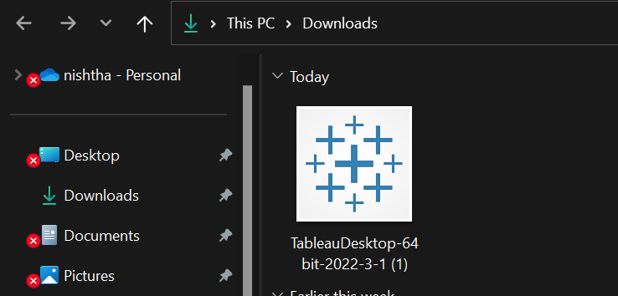
Install tableau

Slide 16
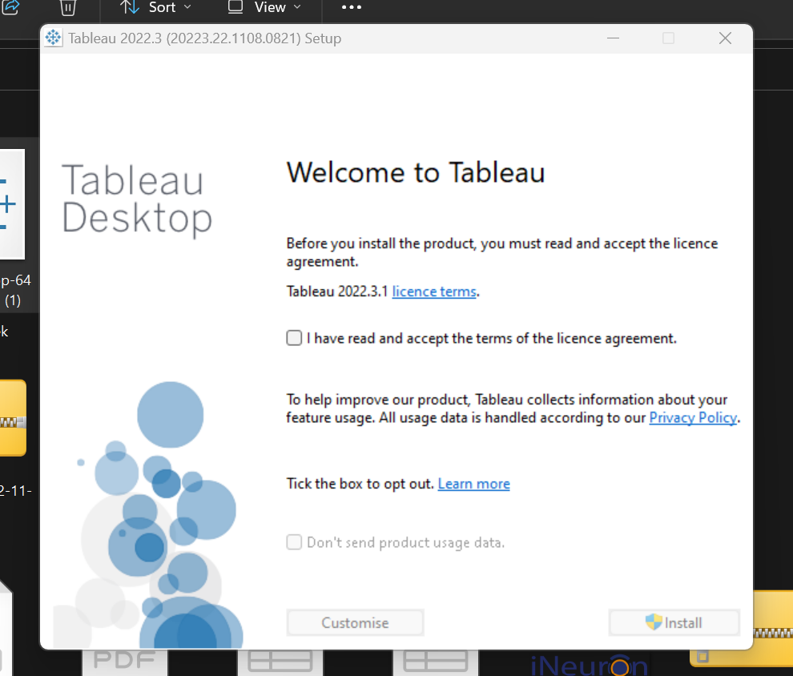
Install tableau

Slide 17
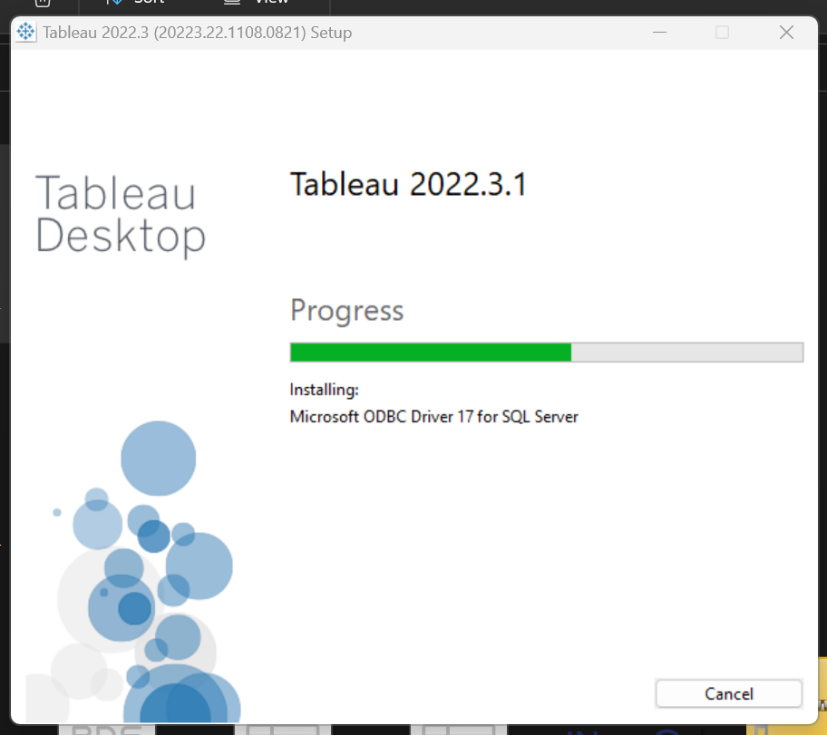
Install tableau

Slide 18
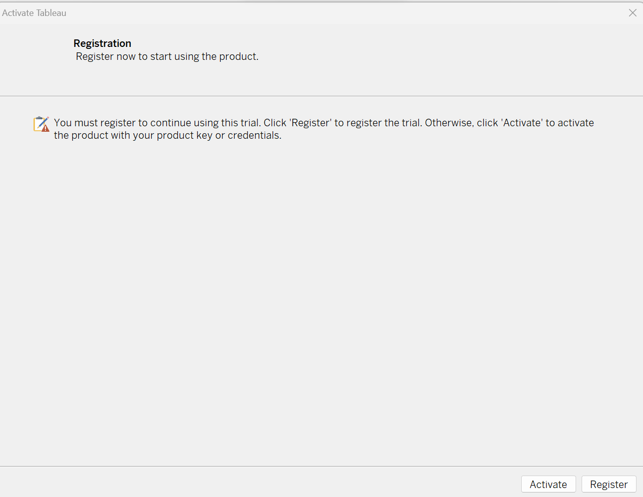
Install tableau

Slide 19
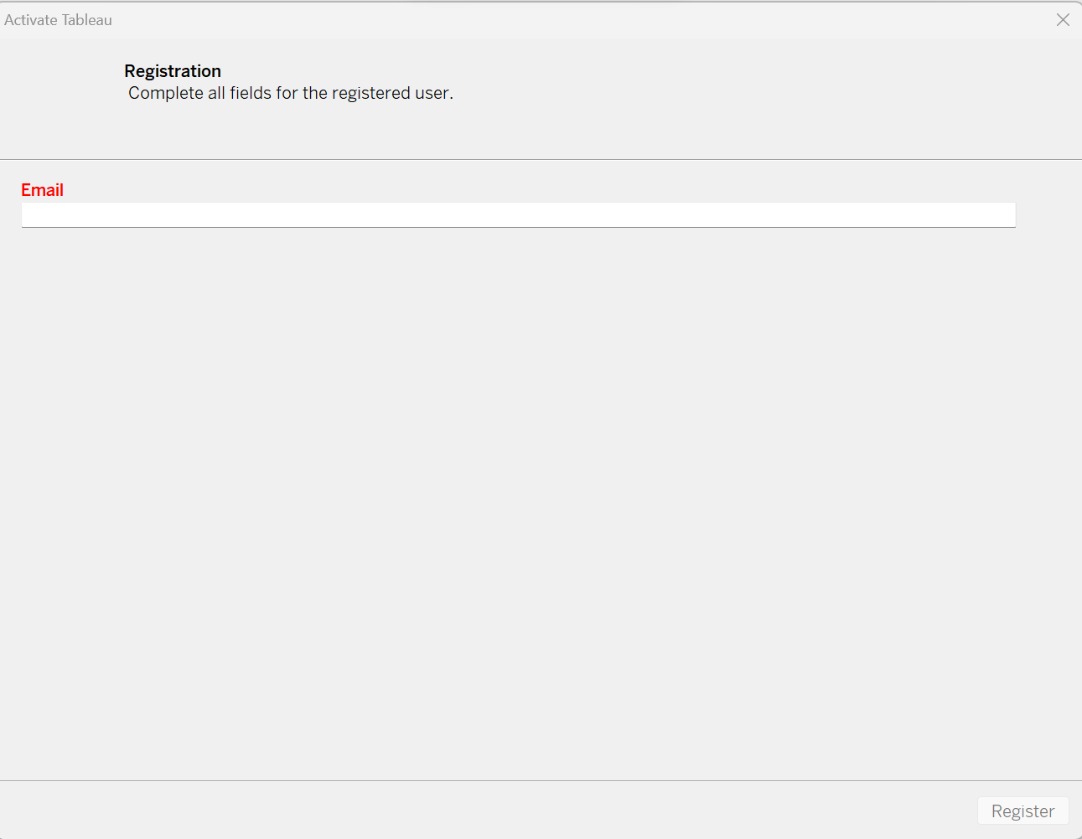
Install tableau

Slide 20
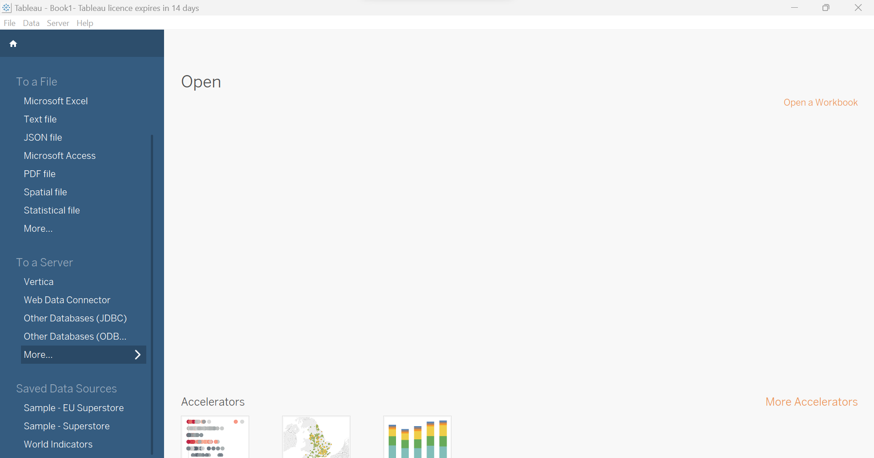
Tableau Installed

Slide 21
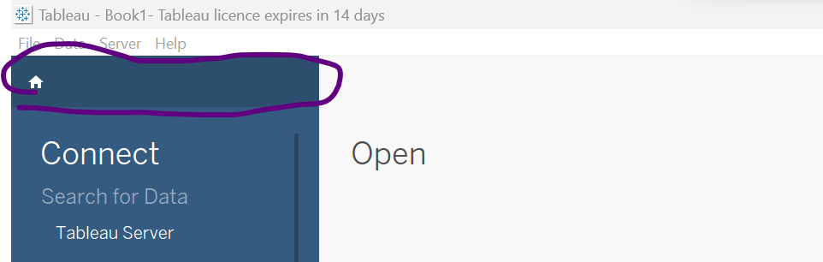
Opening a new workbook

